Slide 1
SOMA session agenda
SONATA Introduction & overview – Wouter Tavernier
SONATA SDK – Wouter Tavernier
Break (10 min)
SONATA Service Platform – Thomas Soenen
Questions & discussion

Slide 2


Software Programming Kit (SDK)
Dr. Wouter Tavernier, Steven Van Rossem
HORIZON 2020
Notes:
Now, that you have better view on the global sonata project, let's dive a bit deeper into the SONATA Software Development Kit

Slide 3

Agenda
SDK in a world of DevOps
Service programming concepts
Workflow
SDK component snapshot
Summary
Notes:
Brief overview of what you can expect
Let me put this work somehow into perspective ... why/what's the problem

Slide 4

The SDK, DevOps & the breakdown of silos
Disconnected teams (silos), information, and perspectives create major stumbling blocks to managing configuration drift between pre-production and production systems
DevOps = automation and integration of development and operations workflows
key aspects: visibility, configuration transparency and collaboration
Understand drift for the entire application service
Optimize for flow not individual processes
Notes:
Let’s start with Devops ... DevOps is a concept which has been well-known in software industry for a couple of years, but is only recently being acknowledged in telecom industry:
what is it about:
software industry recognized some time ago that many companies worked in silos: different teams are working in dev and operations of service, maybe even split over different products ...
hard to design a new service or even feature and bringing it quickly into production environment
continuous drift between both environments, which made it hard to easily progress from one to another environment
DevOps has changed this significantly: focus on process/flow with transparency and collaboration
it is only withe advent of SDN and NFV that telecom services are software-based and might adopt a similar strategy
however, there are many open challenges in which we still focus :
what exactly is a service in this context
how to develop it: focus of this presentation
what is the resulting platform
http://devops.com/2014/05/16/breaking-down-silos/

Slide 5
SDK innovations
One of the first open-source, vendor-independent SDK for NFV
SDK toolset based on light-weight individual tools with well-defined goal and functionality (GIT-alike approach)
SDK emulator environment enabling developers to rapidly validate and deploy the developed service in multi-PoP setting on a limited local environment (e.g., laptop)
Monitoring and analysis tools and process to enable for effective debugging before actually deploying it on true Service Platform
Effective integration operations with service development (DevOps) for 5G
Notes:
Knowing this, what are the innovations that we try to provide with the SDK in SONATA:

Slide 6
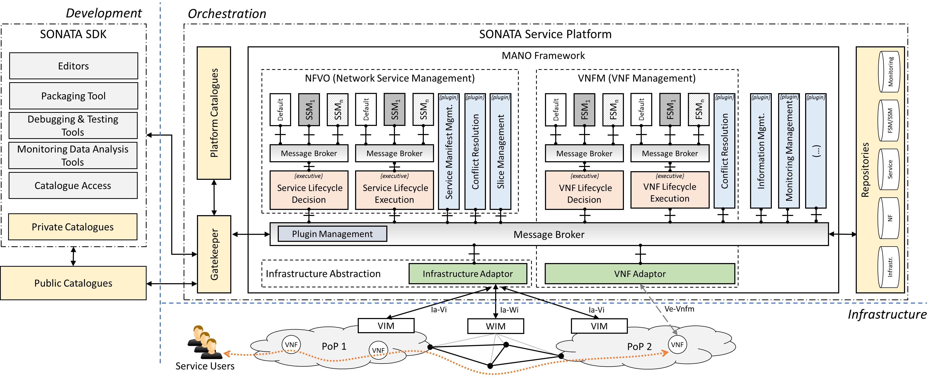
SDK in the global SONATA architecture
Notes:
To remind you back on where we are in the sonata architecture ... here, we focus on the left side
SDK includes tools for ...

Slide 7
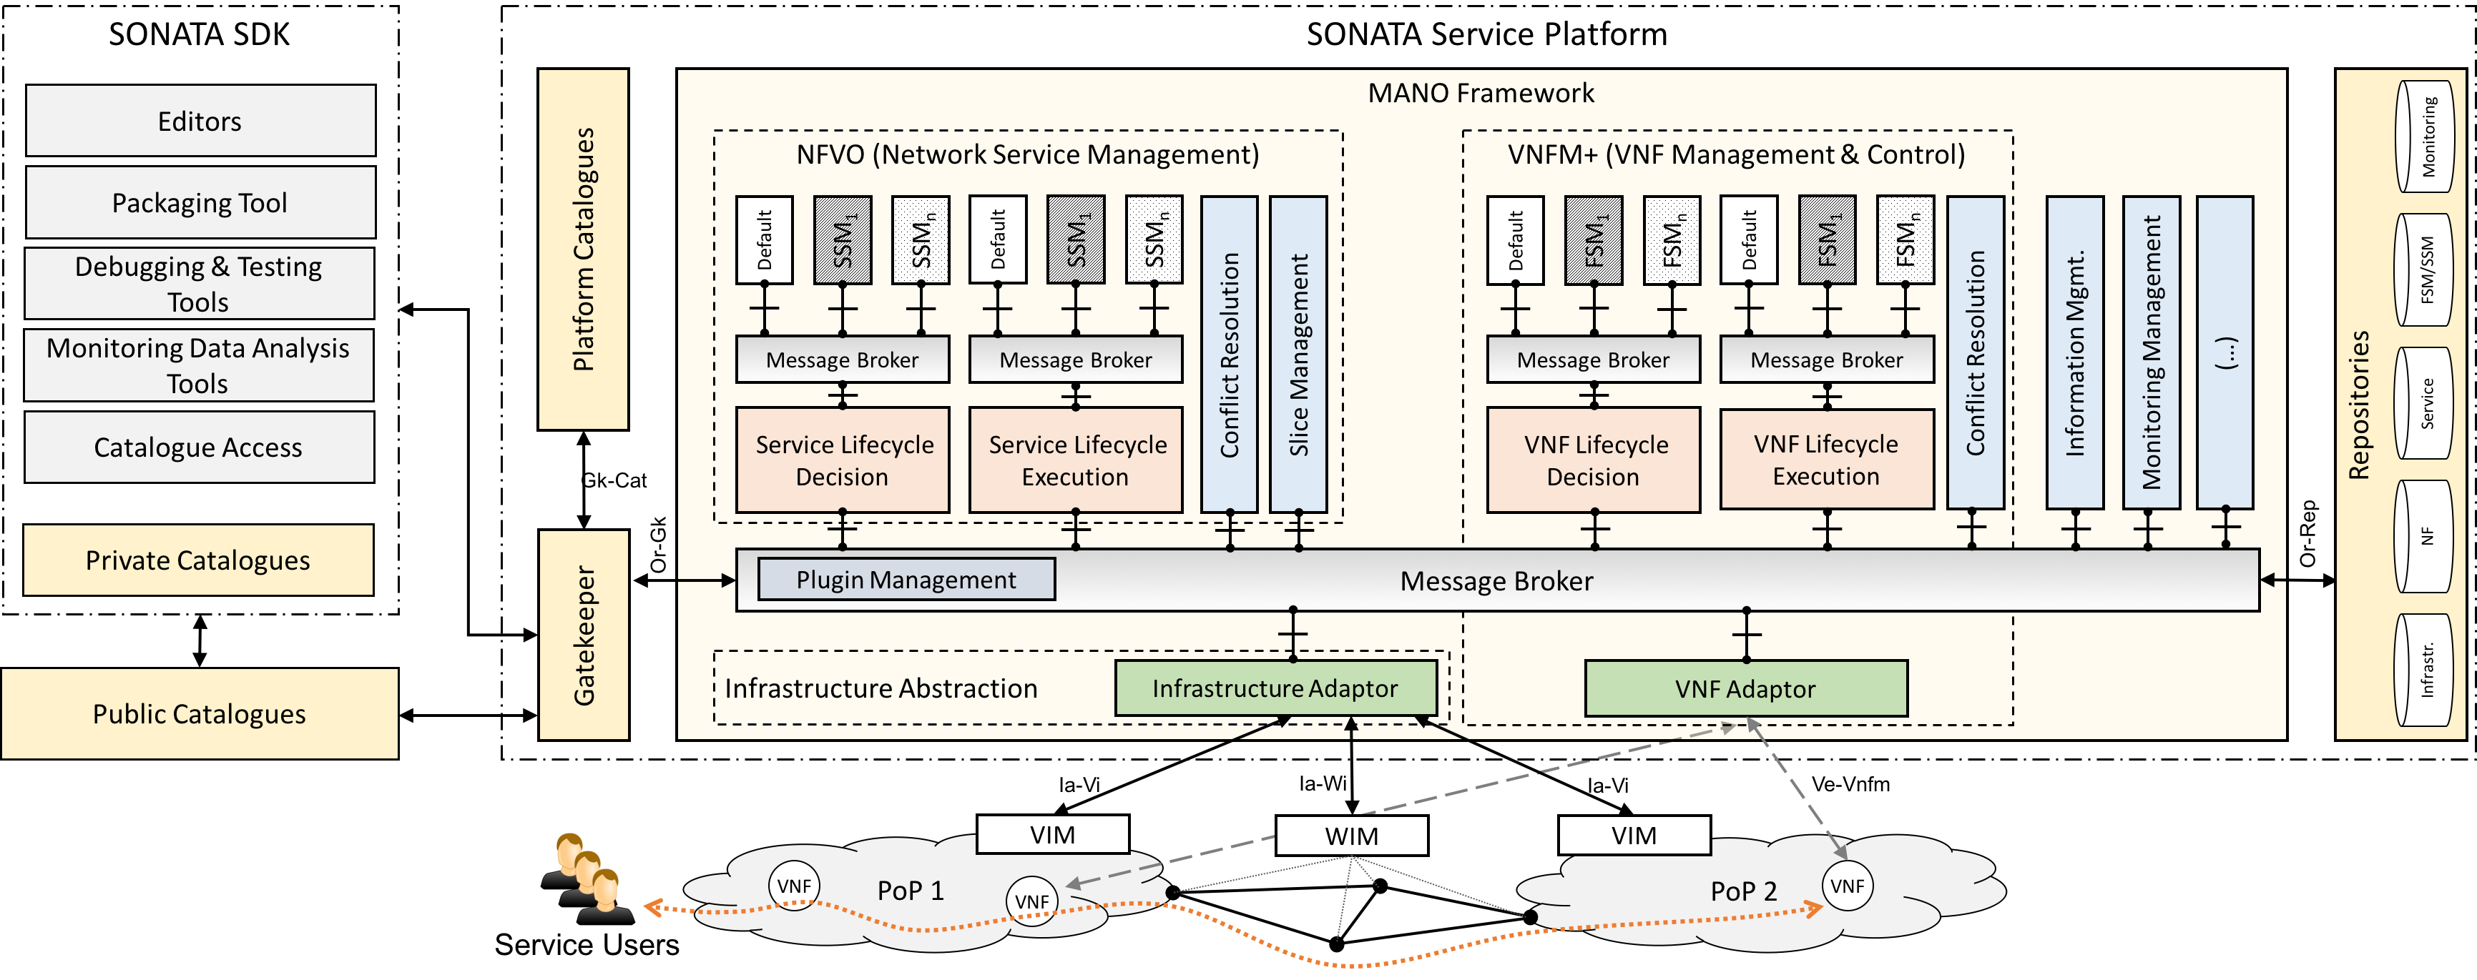

Mapping SDK functionality to components
SDK component
Main functionality
Service Programming Model
Descriptor definitions
Validation tools
son-schema
son-editor
son-workspace
son-project
son-package
son-push
Workspace creation
Project creation
Package creation
Package upload
son-cli
son-emu
son-monitor
son-analyze
NF emulation
Service emulation
Emulator monitoring
Service analysis
Validated descriptor storage
Descriptor access via name trio or UUID
Basic syntax check for descriptors.
CRUD methods for NS and VNF catalogues.
son-catalog
Notes:
So, rather than listing boxes in the architectural plan, let me show what we actually already have implemented (I will come back to these in more detail later)
before you can develop services, you need to have a programming model, this we defined in a set of schema an descriptors
next, we have developed a set of tools for setting up the workspace, packaging and uploading it to the SP
in order to truly debug the developed service, we have created an emulator environment well-integrated with some monitoring and debugging functionalies
last, we have implemented a catalogue functionality for storing descriptors
all of these are not just architectural ideas: they are implemented, and you can download them

Slide 8
Agenda
SDK in a world of DevOps
Service programming concepts
Workflow
SDK component snapshot
Summary
Notes:
I will now go delve a bit deeper in the technical details of these components (where time allows)

Slide 9

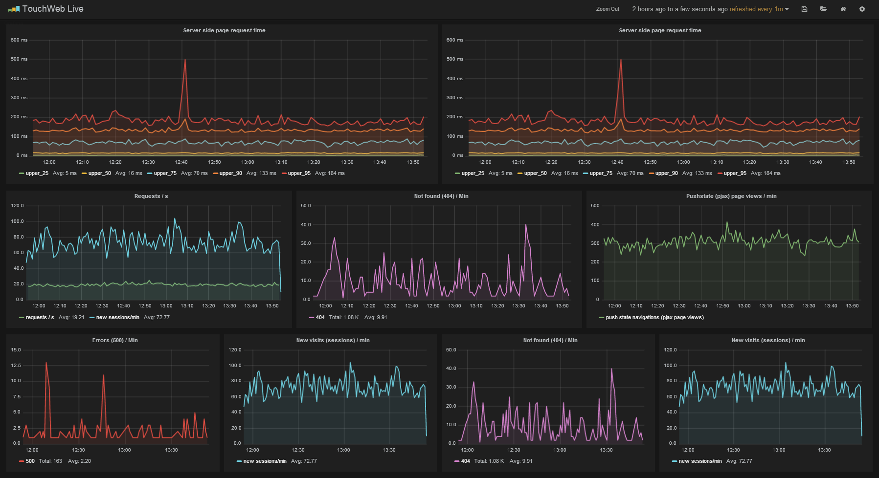
Developing a SONATA service
SONATA service = chain (or graph) of Network Functions, which might be software-based (NFV) and deployed on geographically spread network and node infrastructure
Examples:
Content Delivery Network service consisting of NFs for content caching, load balancing, user tracking, etc.
VPN service consisting of NFs for authentication, Deep Packet Inspection, firewalling, etc.
Simple working assumption for the rest of the presentation: Adaptive Traffic Monitoring Service
input
interface
output
interface
firewall
traffic classifier
Notes:
Let's start with the basics: what is a service?
without going to much into a formal definition ... for SONATA a a service is considered as chain or graph of potentially virtualized network functions
examples are ... the example which will come back today in the SP demo's in the evening session

Slide 10
SONATA Descriptors
Network Service
A Network Service is specified in the Network Service Descriptor (NSD)
A Virtual Network Function is described in a Virtual Network Service Descriptor (VNFD)
The VNFD contains one or multiple Virtual Deploymnent Unit (VDU) templates that describe the Virtual Machines that run the virtual network function
VNF_{A}
VNF_{B}
1
VNFC_{A1}
VNFC_{A2}
VNFC_{B1}
VNFC_{B2}
VDU_{B1} Instance 1
*
VDU_{A1} Instance 1
VDU_{A1} Instance 1
VDU_{A2} Instance 1
VDU_{B1} Instance 2
1
VDU_{A1} Instance 2
VDU_{A1} Instance 2
*
VDU_{B1} Instance 3
Notes:
Now that we have an initial idea of what a sonata service is, let's clarify how it actually looks on your pc:

Slide 11
SONATA Descriptors
Challenges addressed and solved by SONATA (so far)
Identified all the different artifacts that need to be references by all the different entities
VNFDs, PNFDs, VDUs, VLDs, etc.
Developed and implemented an addressing scheme that works across multiple domains
Incorporated other important features incl. monitoring
Virtual Network Function Descriptor
---
descriptor_version: "vnfd-schema-01"
vendor: "eu.sonata-nfv"
name: "firewall-vnf"
version: "0.3"
[...]
virtual_deployment_units:
- id: "vdu01"
vm_image: "sonata-VM-2ports.qcow"
vm_image_format: "qcow2"
resource_requirements:
cpu:
vcpus: 1
[...]
Network Service Descriptor
---
descriptor_version: "1.0"
vendor: "eu.sonata-nfv.service-descriptor"
name: "sonata-demo"
version: "0.2.1"
[...]
network_functions:
- vnf_id: "vnf_firewall"
vnf_vendor: "eu.sonata-nfv"
vnf_name: "firewall-vnf"
vnf_version: "0.3"
[...]
Notes:
So how do these desciptors look like for example for the traffic classifiation service ...

Slide 12
Agenda
SDK in a world of DevOps
Service programming concepts
Workflow
SDK component snapshot
Summary

Slide 13
Service Development Workflow
Service Platform
Deployment (Service Platform)
Monitoring (SP Monitoring)
Analysis (son-analyze)
DevOps: iterative development
Project creation (son-project)
Uploading (son-access)
Deployment (son-emulator)
Debugging (son-monitor)
Analysis (son-analyze)
Packaging (son-package)
Project editing
(son-edit)
Descriptor fetching
Service Development Kit
Time Scale
order of seconds
order of seconds
seconds to min’s
Notes:
at this point in time it is/or should more or less be clear what a sonata service looks like, let's now depict how these fit into the global development and operations workflow:
Let's start with the service development workflow as is the focus of SDK
Starting from the point of service creation at the very left, we want to go to a deployed service which we can analyse to improve it at the right end of the spectrum
On the upper side we have the service platform, we have the service platform, and as you can see, the deployment process actually can be equally easily triggered on the service platform as on the internal developer's environment, and the analysis can be done in a very similar way, enabling iterative and transparent deployment across the two environments: which is exactly following this DevOps approach

Slide 14
Agenda
SDK in a world of DevOps
Service programming concepts
Workflow
SDK component snapshot
Summary
Notes:
Now, given the limited time we have, I will quickly go through this workflow from the SDK point of view and highlight the functionality of each of the developed components, let's start with the project creation

Slide 15
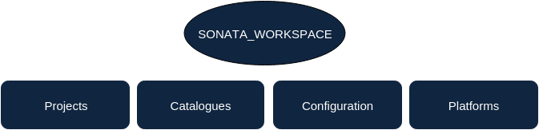
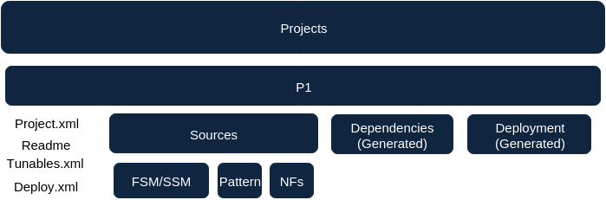
Project creation – son-workspace/son-project
Create workspace
Keep developer custom configurations
catalogue repository addresses
schema repository location
Create projects
Instantiate base service project skeleton
Creation of sample service and function
Enables interaction with packaging functionality, catalogues and SP
Uploading (son-access)
Deployment (son-emulator)
Debugging (son-monitor)
Analysis (son-analyze)
Packaging (son-package)
Project creation (son-project)
Project editing
(son-edit)
Descriptor fetching

Slide 16
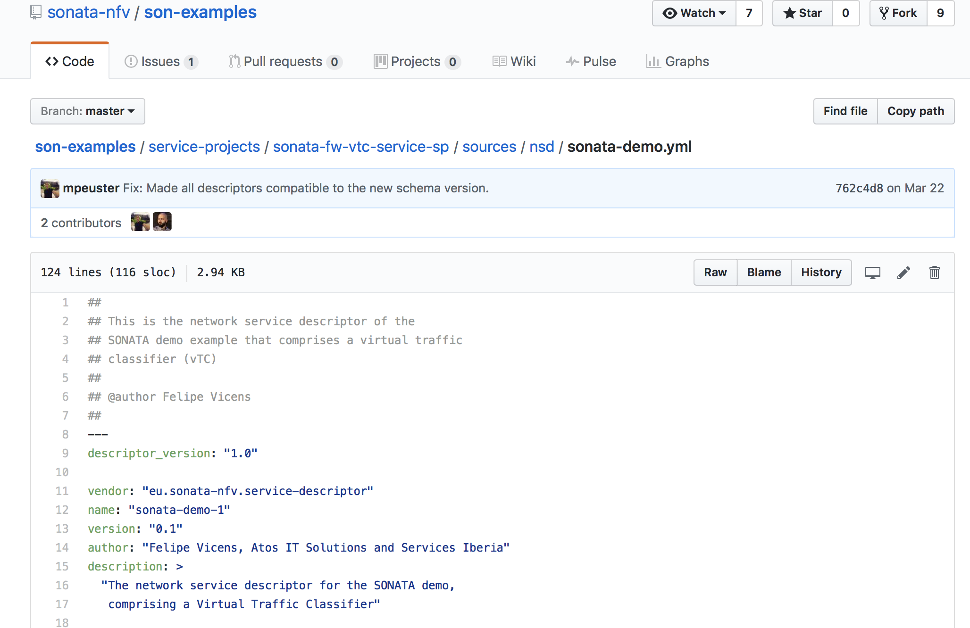
Descriptor fetching – from GitHub, etc.
Developer’s local storage for network service & NF descriptor needs.
Availability of valid existing network service and virtual network function descriptors to facilitate network service development
Access/connectivity to 3rd party / public websites or catalogues.
Project creation (son-project)
Uploading (son-access)
Deployment (son-emulator)
Debugging (son-monitor)
Analysis (son-analyze)
Packaging (son-package)
Descriptor fetching
Project editing
(son-edit)

Slide 17
Project editing - son-editor
Graphical tool and editor of service and NF descriptors
Web-based technology consisting of front-end and back-end part communicating via REST API
Supports interaction with GitHub for fetching existing projects & descriptors
son-editor frontend
REST API
son-editor backend
son-cli
tools
Project creation (son-project)
Uploading (son-access)
Deployment (son-emulator)
Debugging (son-monitor)
Analysis (son-analyze)
Descriptor fetching
Project editing
(son-edit)
Packaging (son-package)

Slide 18
Packaging – concept
Packages are the primary artifact in the SONATA ecosystem
Created using the SDK
Shipped to catalogs and the SONATA Service Platform
SONATA supports slim and fat packages
A slim package contains references to artifacts
A fat package contains all the artifacs
Package Descriptor (Manifest.MF)
---
descriptor_version: "1.0"
vendor: "eu.sonata-nfv.service-descriptor"
name: "sonata-demo"
version: "0.2.1"
[...]
package_content:
- name: "/service_descriptors/sonata-demo.yml"
content-type: "application/sonata.service_descriptor"
md5: "0bb347f5bcd4986fccfc44ee87932c48"
[...]
Project creation (son-project)
Uploading (son-access)
Deployment (son-emulator)
Debugging (son-monitor)
Analysis (son-analyze)
Packaging (son-package)
Descriptor fetching
Project editing
(son-edit)

Slide 19



Packaging – son-package functionality
Packaging of project into a single file
Solves external project dependencies
Retrieval of remote project descriptors from SDK catalogues
Syntax validation of descriptors against the latest schema definitions
Generation of a MANIFEST/MD5 hash
1. Developer executes create package
SONATA SDK
1
Son-package
2. Son-package retrieves required NSD/VNFD from the SDK catalogues.
2
SDK Catalogues
NSDs
VNFDs
Project creation (son-project)
Uploading (son-push)
Deployment (son-emulator)
Debugging (son-monitor)
Analysis (son-analyze)
Packaging (son-package)
Descriptor fetching
Project editing
(son-edit)

Slide 20
Uploading – son-access
Uniform SDK interface to either the Service Platform’s Gatekeeper or the SDK emulator (emulated Service Platform)
Upload service packages to Gatekeeper
Obtain list of available packages from Gatekeeper
View the list of instantiated services
Can be extended to support any Service Platform (using REST api)
Project creation (son-project)
Uploading (son-access)
Deployment (son-emulator)
Debugging (son-monitor)
Analysis (son-analyze)
Packaging (son-package)
Descriptor fetching
Project editing
(son-edit)

Slide 21
Deployment - son-emu motivation
For a developer it is ...
not easy to validate their complex/distributed service chains
non-trivial to test them in realistic multi-PoP environments
time consuming to investigate effects caused by recent changes in any of their sub-components
Classic cloud testbeds are expensive and require many resources
Develop platform capable of emulating multiple NFVI PoPs on single laptop
Executing VNFs as containers
Enable quick iterations to test complex service chains in well-defined setups
Developers can directly manipulate components of the running service chain
Project creation (son-project)
Uploading (son-push)
Deployment (son-emulator)
Debugging (son-monitor)
Analysis (son-analyze)
Packaging (son-package)
Project editing (manual)
Descriptor storage (son-catalog)
Notes:
As known to people in cloud environments and infrastructure management, an openstack cluster requires a lot of resources, and can make it hard to quickly test developed services. for this main reason, we developed an emulator which enables to deploy developed services o na local development environment. This even enables to emulate multiple points of presence (equiv of multiple openstack lcusters). As far as we know, we are one of the first to actually provide such an environment, and we believe it is crucial to drastically improve and speed up the development process of NFV-based services.

Slide 22
Deployment – son-emu scope vs. ETSI model
NFV Management and Orchestration (MANO)
Focus on NFVI+VIM
MANO “batteries included” as “Dummy Gatekeeper”
Offers interface similar to the real SONATA service platform gatekeeper
Architecture:
Modular design based on Containernet¹
Flexible APIs to extend/customize the platform
Interactive CLI
OSS/BSS
NFVO
EM
VNFM
VNF
VNF
VNF
VNF
VNF
VNF
son-emu platform
NFVI
VIM
NFVI
VIM
NFVI
VIM
Project creation (son-project)
Uploading (son-push)
Deployment (son-emulator)
Debugging (son-monitor)
Analysis (son-analyze)
Packaging (son-package)
Project editing (manual)
Descriptor storage (son-catalog)
Notes:
So what do we actually provide with the emulator. Let''s put this in perspective of the well-known ETSI architecture:
etsi distinguishes between the following comopnents:
on the control side: a mano platform, consisting of a orchestrator and vnfm management functionality
on the customer side we have the OS/BSS and a couple of EM managers, interacting with the mano side
on the instantiated service side we have the VNFs
VNFs are actually deployed on infrastructure, network and server infrastructure, in practice it is easy to think about it as an openstack environment together with a network infrastructure (e.g. SDN-driven)
our emulator focuses on the emulation of this infrastructure environment, while the SP focuses on the mano part
however, as the SP was ongoing in y1, the emulator also provided a dummy mano environment with similar interfaces, in order to have "all batteries included" to test your developed service on your developer's env

Slide 23

Deployment – son-emu features
Emulated multi-PoP environment
PoP 2
Interactive, cloud-like rapid prototyping platform
Executed on developer’s laptop
Production-ready network services
Executes container-based VNFs
Custom multi-PoP topologies
Service Chaining support
MANO system integration
Integrates with SONATA workflow and tools
VNF2
20ms
s
8ms
15ms
PoP 1
15ms
VNF1
t
VNF3
Project creation (son-project)
Uploading (son-push)
Deployment (son-emulator)
Debugging (son-monitor)
Analysis (son-analyze)
Packaging (son-package)
Project editing (manual)
Descriptor storage (son-catalog)
Notes:
We will demonstrate the emulator in detail in the demo this afternoon, but these are the main features ...

Slide 24

Deployment – son-emu usage workflow
Topology
Emulated multi-PoP environment
2
execute
PoP 2
interact
VNF2
1
Emu-Core
20ms
define
s
interact
8ms
15ms
develop
PoP 1
15ms
Developer
VNF1
MANO Endpoint
t
VNF3
“son-push”
SONATA Service Package

Slide 25
Debugging – SDK son-monitor objectives
Newly developed service might contain bugs
Functionality bugs (not working as intended)
Performance bugs
Newly developed service might be not well understood
son-monitor = range of debugging and profiling features to investigate
Enable a more efficient development and deployment workflow for a network service.
Provide a dataset of metrics that further analysis (e.g., workload prediction, scaling thresholds). Metrics might be pre-processed (aggregated, etc.)
Project creation (son-project)
Uploading (son-push)
Deployment (son-emulator)
Debugging (son-monitor)
Analysis (son-analyze)
Packaging (son-package)
Project editing (manual)
Descriptor storage (son-catalog)

Slide 26

Debugging – SDK son-monitor flow
Service Definition
Emulated multi-PoP environment
input
interface
output
interface
PoP 2
VNF2
son-monitor
+
database
firewall
traffic classifier
20ms
Descriptors
describe network service
package the service
push to platform
NSD
VNFD
incl. monitoring metrics
s
8ms
15ms
during deployment
PoP 1
15ms
generate traffic
monitor additional customized metrics
VNF1
Functionality
further testing of the deployed service
RX/TX
t
VNF3
after deployment

Slide 27
Analysis - son-analyze motivation & concept
Services are continuously changing in DevOps fashion
New actors may wish to enter the network world
How to analyze a dynamic, software-based environment ?
Workload prediction
SLA violation
Development framework for building custom analysis over services
Interactive User Interface with graph capabilities
Integrates with the SONATA SP and the SONATA SDK
High-level structures around services’ metrics
Project creation (son-project)
Uploading (son-push)
Deployment (son-emulator)
Debugging (son-monitor)
Analysis (son-analyze)
Packaging (son-package)
Project editing (manual)
Descriptor storage (son-catalog)

Slide 28
Analysis - son-analyze workflow

Slide 29

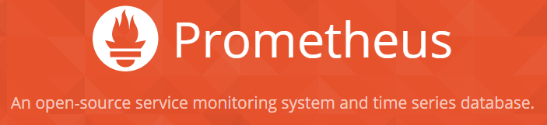



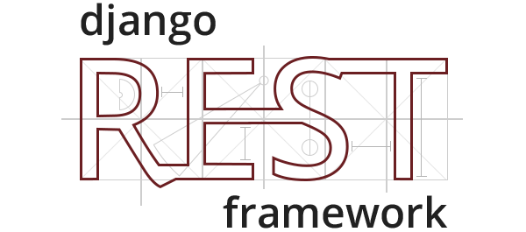







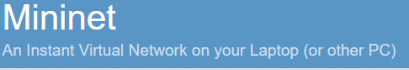
Technologies used
python

Slide 30
Agenda
SDK in a world of DevOps
Service programming concepts
Workflow
SDK component snapshot
Summary

Slide 31
Summary
One of the first open-source, vendor-independent SDK for NFV
SDK emulator environment enabling developers to rapidly validate and deploy the developed service in multi-PoP setting on a limited local environment (e.g., laptop)
Working prototype, open-source code base with clear roadmap available
Effective integration operations with service development (DevOps) for 5G

Slide 32
SOMA session agenda
SONATA Introduction & overview – Wouter Tavernier
SONATA SDK – Wouter Tavernier
Break (10 min)
SONATA Service Platform – Thomas Soenen
Questions & discussion

Slide 33
SOMA session agenda
SONATA Introduction & overview – Wouter Tavernier
SONATA SDK – Wouter Tavernier
Break (10 min)
SONATA Service Platform – Thomas Soenen
Questions & discussion

Slide 34
SOMA session agenda
SONATA Introduction & overview – Wouter Tavernier
SONATA SDK – Wouter Tavernier
Break (10 min)
SONATA Service Platform – Thomas Soenen
Questions & discussion

Slide 35
2 SONATA-focused sessions on SOFTNETWORKING
SOMA: Presentation-focused project overview = session on Monday afternoon (16:30 - 18:00)
DEMO: Demo- & hands-on focused SONATA software overview = session on Monday evening (18:40 - 20:30)
a) you are all invited to join and actively participate in the hands-on session!!
b) check https://github.com/sonata-nfv/son-tutorials/ for preparing active participation

Slide 36
Backup

Slide 37

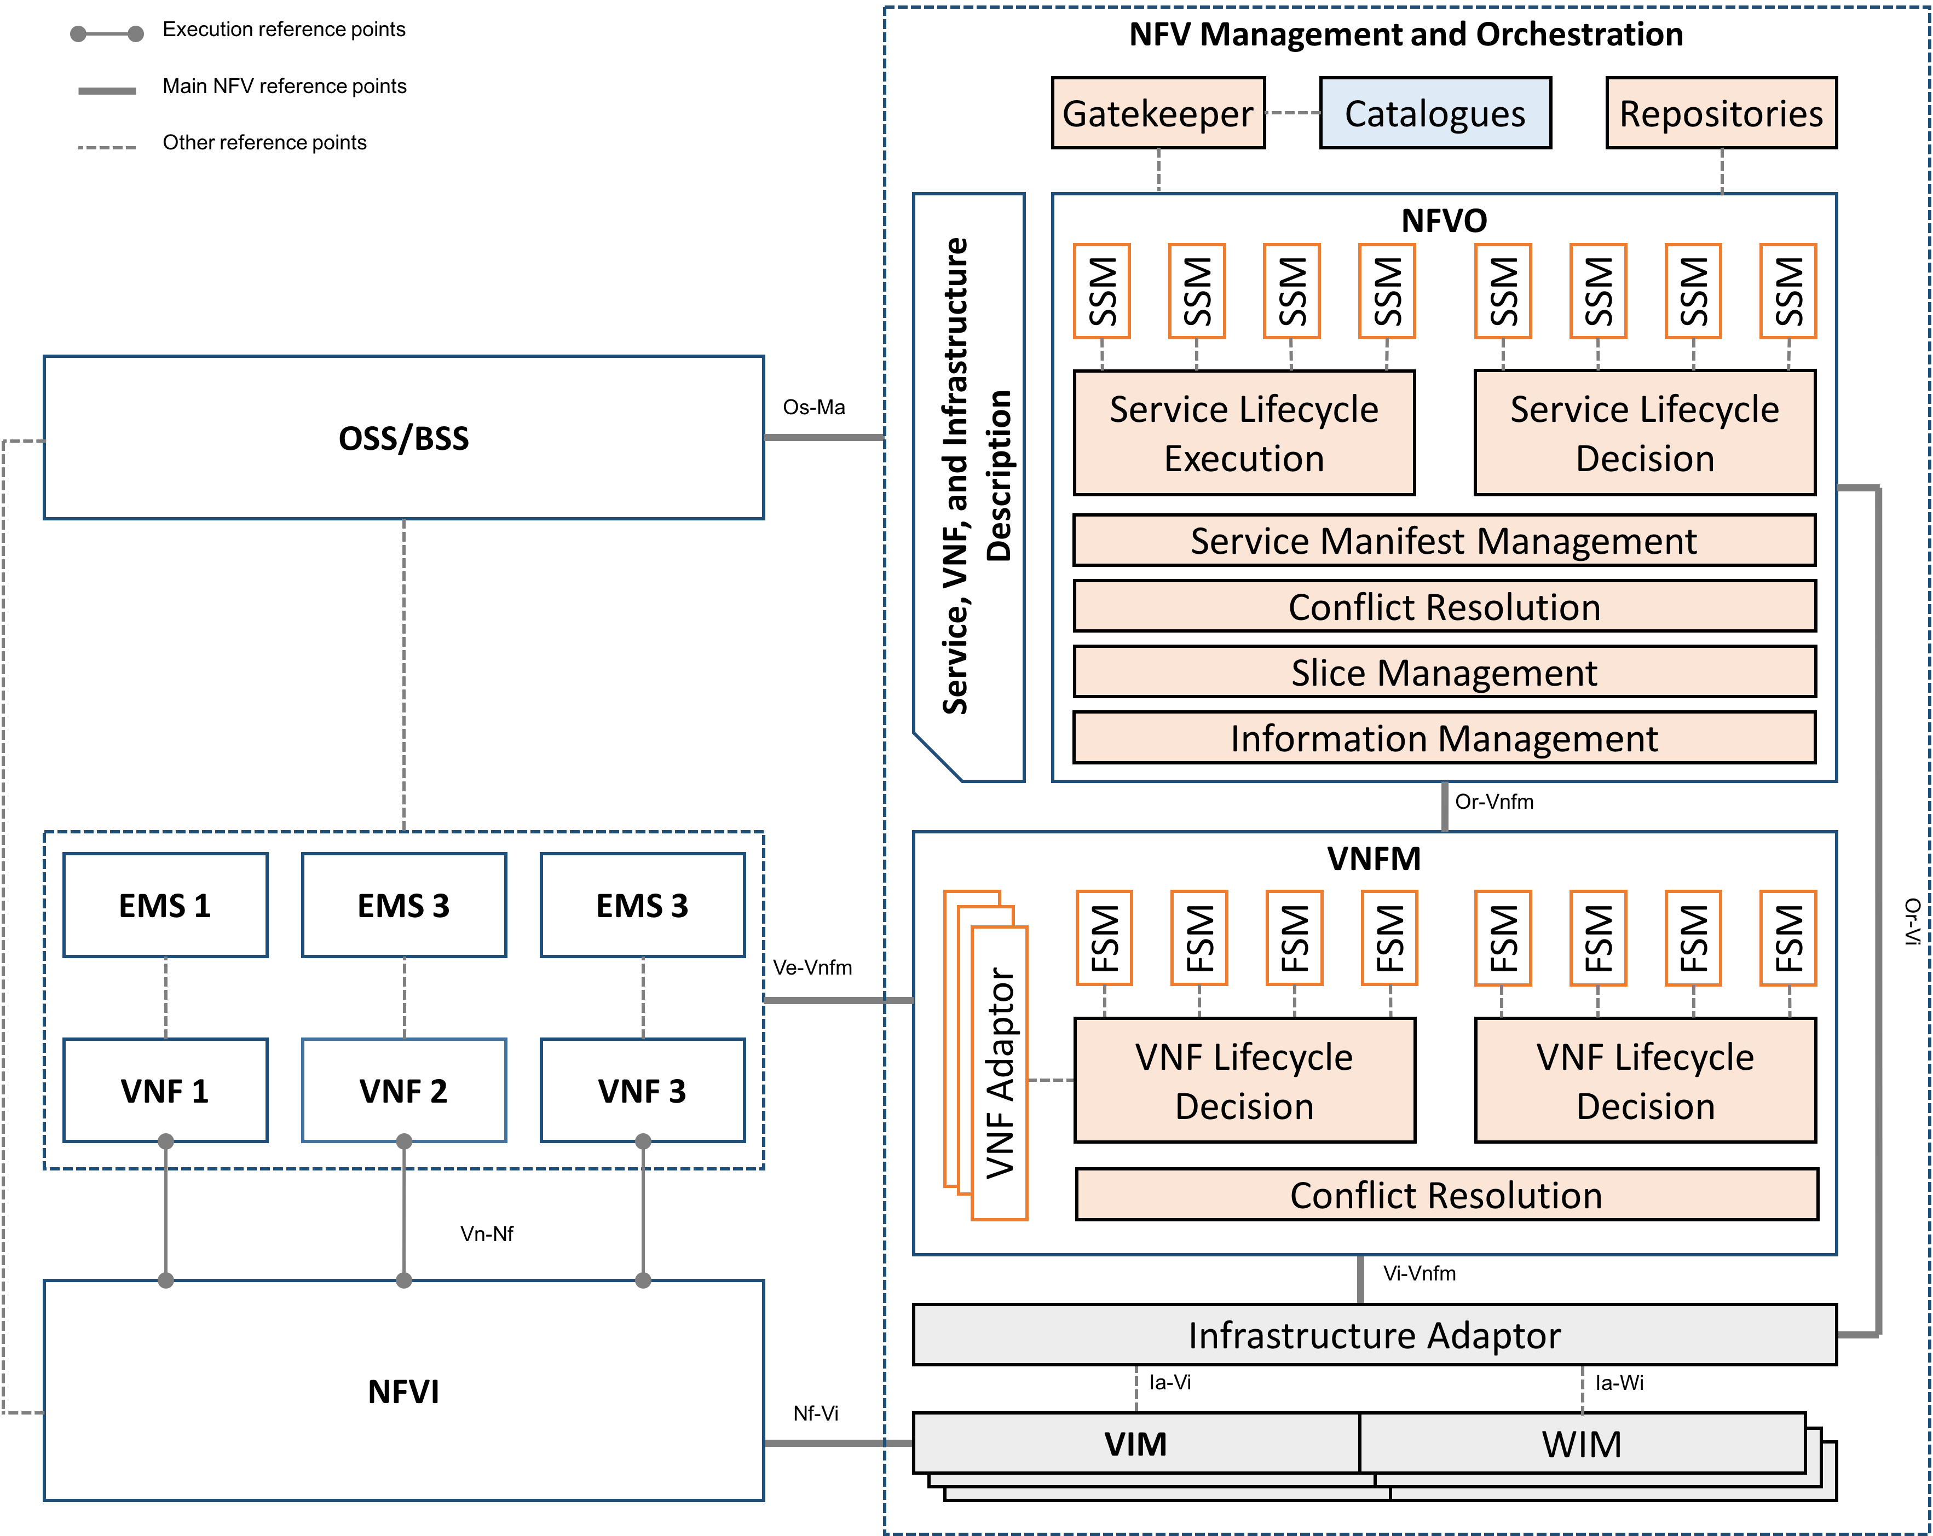
Specific Management Components
Specific Manager
=
Generalization of the ETSI VNFM concept
Define management processes for:
Individual network Functions (Function-Specific)
Entire SONATA Service (Service-Specific)
Deployed as a micro-service (container) in the SONATA Service Platform
Enable direct interaction with MANO framework:
ask additional/changed resources for scaling
steer the placement process

Slide 38
SDK interfaces
Filesystem is the core “interface” in the SDK, as it is focused on a working/project space for a service
Interaction with continuously running components (in particular the GK of the SP) focuses on REST api’s

